Slide 1
OLX - Home Assignment
Raz Malka

Slide 2
Outline
Problem statement
Assumptions & Data examination
Transfer learning
Pipeline
Preprocess
Network architecture
Hyper-parameters search
Training
Future work

Slide 3
Problem statement
Given a set of fashion items, each includes one or more images, classify each item to one of ten categories

Slide 4
Assumptions & Data examination
Independant training - each image is treated independantly.
Multi - class problem
Training set ~ 10K
Imbalanced dataset
Correlated classes

Slide 5
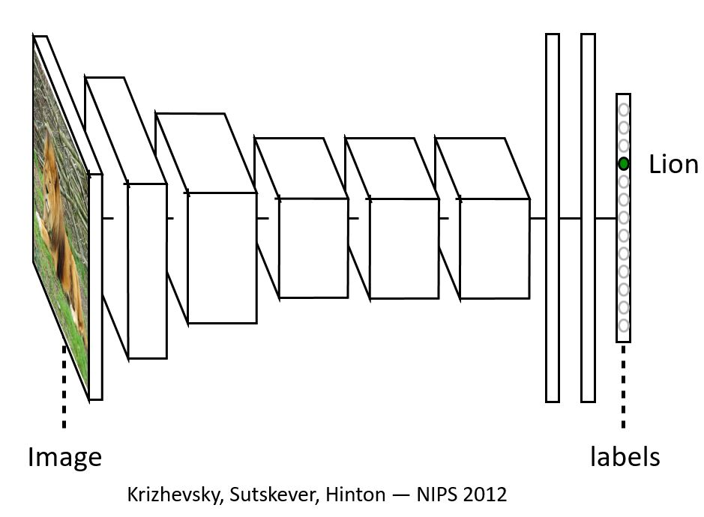
Convolutional neural network

Slide 6
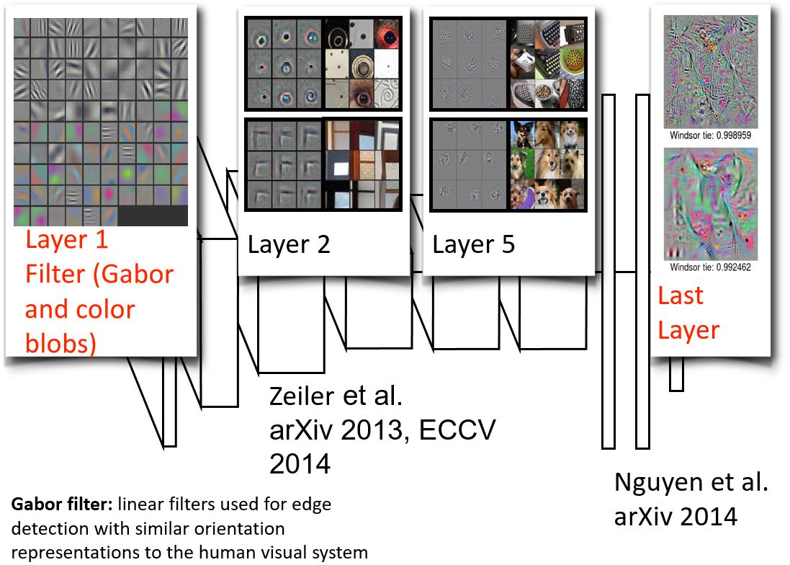
Convolutional neural network

Slide 7
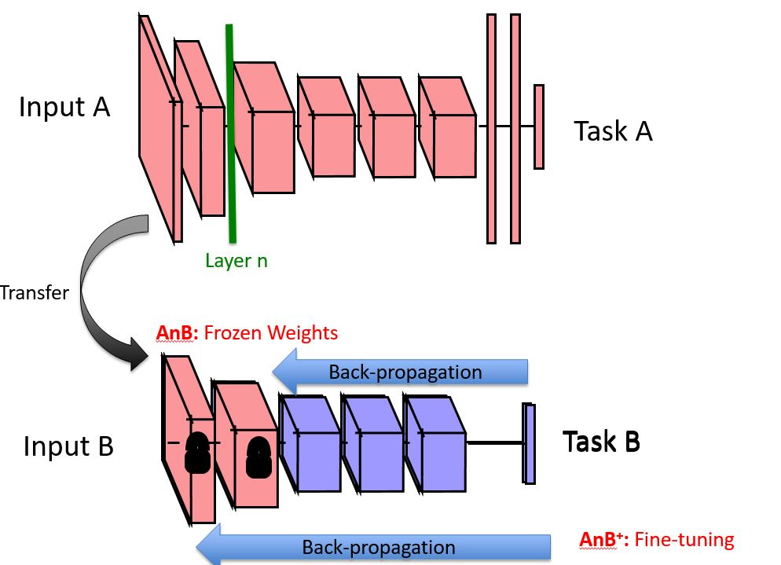
Transfer learning

Slide 8
Pipeline
Preprocess
Resize images to 224x224 keeping aspect ratio
Subtract Imagenet mean pixel value from all images
Augmentation
Mirroring (flip left to right)
Shift
Zoom

Slide 9
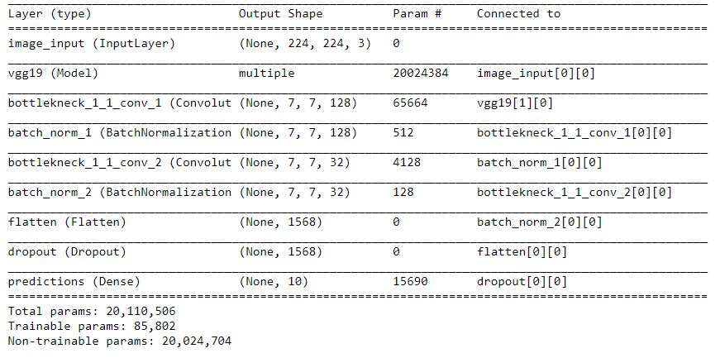
Pipeline
Architecture
Feature extractor - VGG19
Truncate head
1x1 convolutions
Batch normalization
Softmax layer
Dropout
L2 regulariztion (weight decay)
Loss - categorical cross entropy

Slide 10
Pipeline
Hyper-parameter search
Architecture based - number of filters in 1x1 conv, freeze layer, head type
Random search (log space) of learning rate, weight decay and dropout
Batch size
learning rate schedule
One epoch for each set
Many more parameters - long time to compute all options.

Slide 11
Pipeline
Training
85% training / 15% validation
Adam optimizer
Train over best hyper-parameter set for many epochs
83% accuracy on validation set
Investigated Confusion matrix - imbalance
Weighted loss - better precision, less accuracy
Fully trained over 100% of labeled data

Slide 12
Future work
Input
Bigger input / original size image
Define input as an item rather than image - weighted vote
Novel architectures - Multiple feature extractors with aggregation layers on top
Luminance based data augmentation (Lab color space)
Apply gcn to all images

Slide 13
Future work
Data structure / Handling imbalance dataset
Different metric - precision/recall (weighted loss)
Heavily augment small classes
Cascade classifiers - structured data
Architecture
Try Resnet50
Truncate base model before last convolution
Divide & conquer for hyper-parameter search
Visualization using deconvolution techniques

Slide 14
Appendix
results_test.txt - Output file
clf_report_and_confusion_matrix.txt
model_summary.txt - Chosen hyper-parameters
my_net.txt - Used architecture
vgg19.txt - vgg19 architecture

